Slide 1
AWS cloud formation

Slide 2
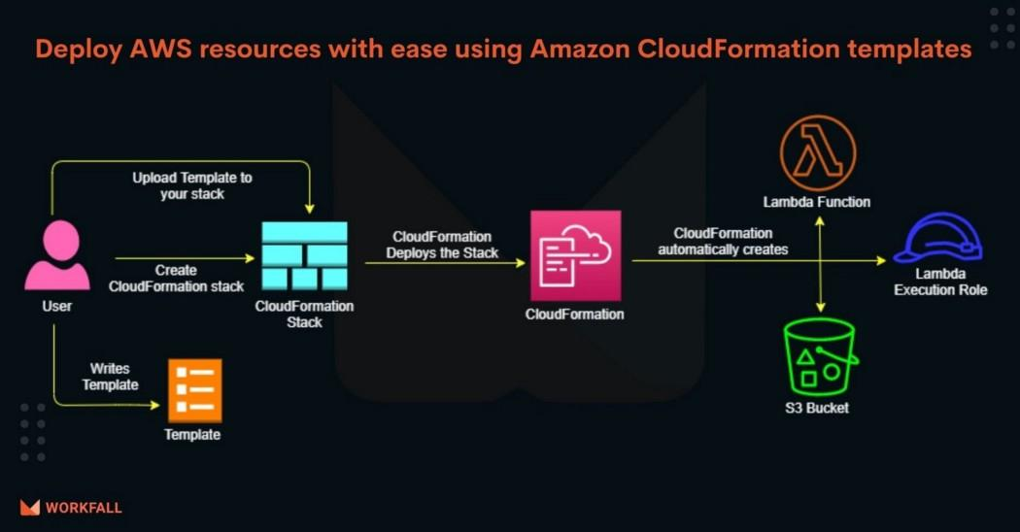

Slide 3
What is AWS CloudFormation
AWS CloudFormation is an IaC tool which helps in managing the AWS infrastructure resources by assisting in simple modeling and setting up with ease in an orderly manner. It is easier to build a CloudFormation using a template design which can be designed with respect to user preference. For example, a template can be defined as what the application requires like an Amazon Elastic Compute Cloud (EC2) instance.

Slide 4
The major advantage is that the user needs not assess the dependencies or complexities of the infrastructure services that are uploaded to the CloudFormation portal, with that of the application running on top. Once the template is designed, it is vetted and validated, the CloudFormation analyses and contemplates the resources users define.

Slide 5
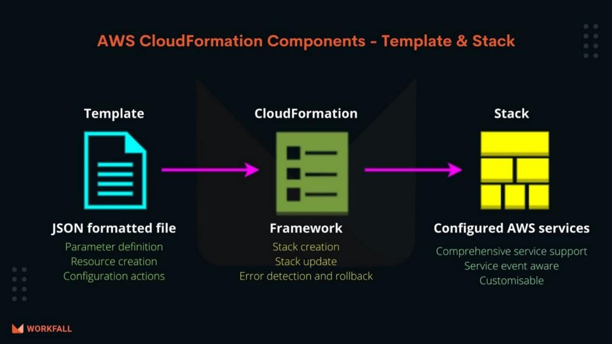

Slide 6
AWS CloudFormation Template
A template is a simple text file that contains the declaration either in JavaScript Object Notation (JSON) or in a YAML Standard which can be edited using a normal text editor or even a CloudFormation editor. These templates can be managed in the source control system.

Slide 7
AWS CloudFormation Stack
In AWS CloudFormation multiple related resources are managed in a single unit called Stack. One can delete, create and update a resource in a stack. These stacks are clearly defined by the stack’s template in AWS CloudFormation.

Slide 8
How AWS CloudFormation works
Build a template based on various requirements and saved in the system.
Use the AWS CloudFormation to create a stack on the template defined.
AWS CloudFormation then diagnoses the template design and the configuration to verify the template on dependencies and validate as well as analyse before provisioning the template for the resource.

Slide 9
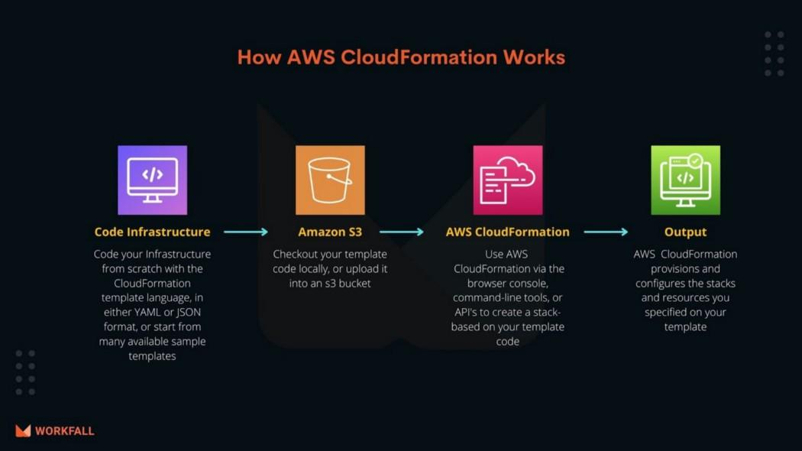

Slide 10
Features and benefits of AWS CloudFormation
AWS CloudFormation gives us an easy way to model a collection of related AWS and third-party resources, provision them quickly and consistently, and manage them throughout their life cycles, by treating infrastructure as code.
A CloudFormation template describes our desired resources and their dependencies so we can launch and configure them together as a stack.
We can use a template to create, update, and delete an entire stack as a single unit, as often as we need to, instead of managing resources individually. We can manage and provision stacks across multiple AWS accounts and AWS Regions.

Slide 11
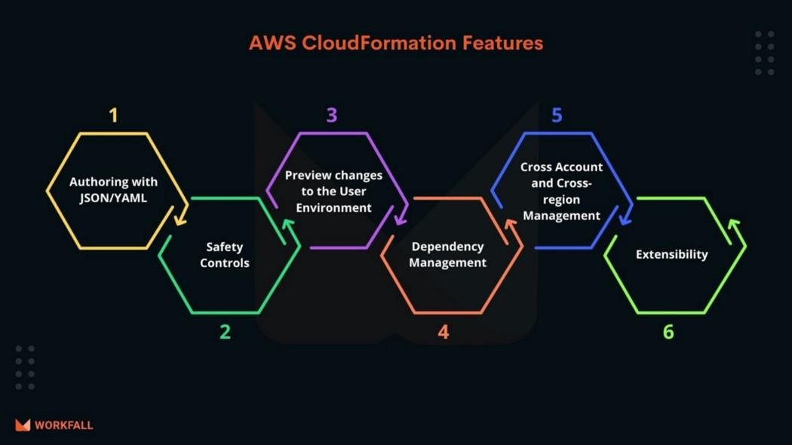

Slide 12
